Slide 1
Lambda expressions & streams

Slide 2
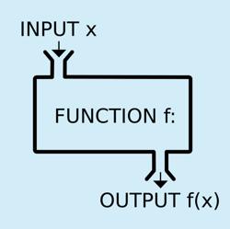
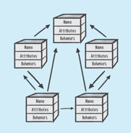
What are Lambda expressions?
Functional ⬄ Object Oriented
Lambda expressions are functions that can be passed around as arguments.
Using lambdas, you can create "anonymous methods" that implement functional interfaces with a more concise syntax.
Lambdas have become increasingly popular with the movement towards more functional programming (<-> Object Oriented): A Lambda is more like a function than a method. This is because a method belongs to a class whereas a Lambda doesn’t. But just like a method, a Lambda accepts a list of parameters, has a body and can return a value.

Slide 3

Why use Lambda expressions?
A more concise syntax: lambda expressions allow to implement a functional interface with fewer lines of code
Lambdas make it easier to work with collections and streams

Slide 4

Lambda functions
Video

Slide 5
Lambda Syntax
Argument List (a,b): The argument list is a comma-separated list of parameters enclosed in parentheses. These arguments usually don't require type declarations as their types can be inferred by the compiler. The parentheses () are optional if you only have a single argument.
2) Arrow token ->
This is the syntax for lambda expressions and signifies the passing of the parameters to the body.
3) Body {}
The body is a code block that represents the implementation of a functional interface. If the body is a single statement, the expression will evaluate and return the result. In this case, the brackets {} are optional. If the body is more than a single statement, you must use brackets and return the result.
Expressions are limited. They have to immediately return a value, and they cannot contain variables, assignments or statements such as if or for.

Slide 6
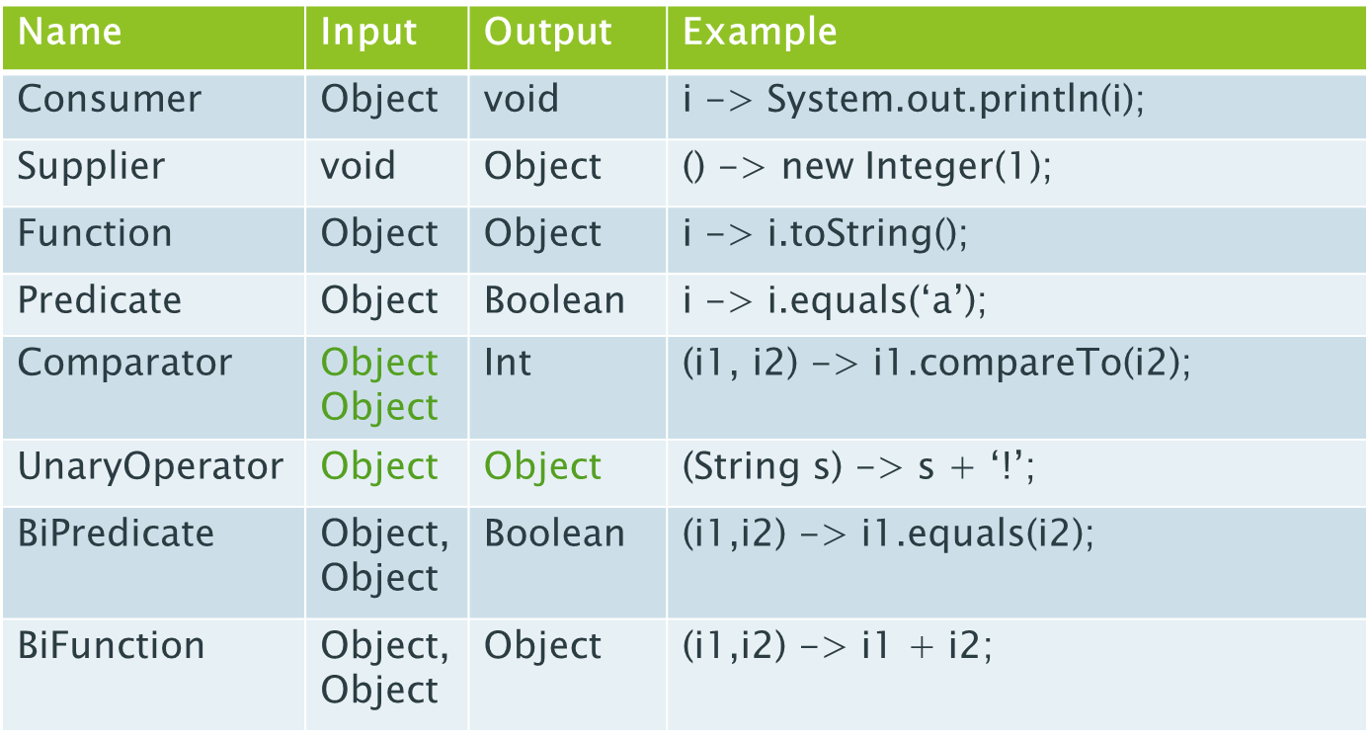
The java.util.function package
Java provides a set of reusable, generic, functional interfaces that are ready for use out of the box in the package java.util.function:

Slide 7
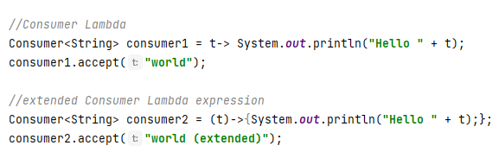
Consumer Example
parentheses () and brackets {} are not mandatory if you have only one argument / statement

Slide 8
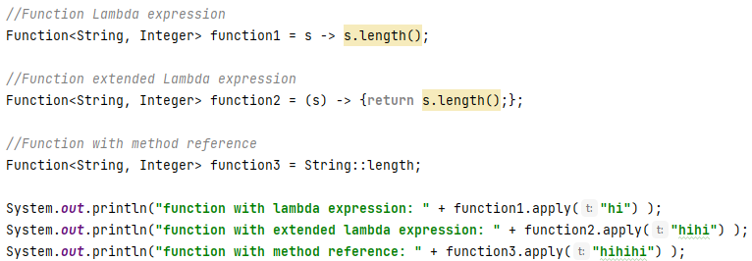

Function Example
The general syntax for a method reference is:
With a method reference, you don't need to worry about passing arguments. In the above example, the compiler can infer the argument based on the method definition of length().
IntelliJ suggests to use a method reference wherever this is possible. That is why the code is yellow…

Slide 9


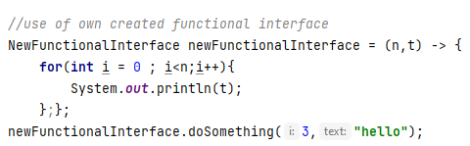
Example of own created functional interface
A functional interface in Java is an interface that contains only one single abstract (unimplemented) method

Slide 10
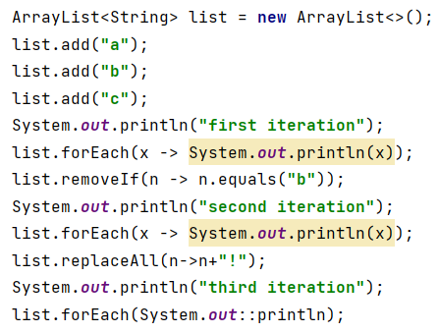
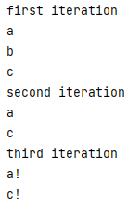
Lambdas in collection-methods - Examples
In java api doc 17:
Consumer, UnaryOperator and Predicate = functional interfaces (in the java.util.function-package) that can be implemented using a Lambda expression
super E = ArrayList implementation. In this case “String”
Also System.out.println(x) can be replaced bij a method reference.

Slide 11
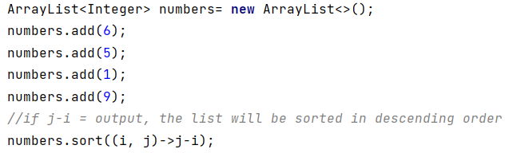
Lambdas in collection-methods – Examples2
In java api doc 17:
a Comparator-implementation returns an Integer (j-i) which is used in the sort-method to define the sequence.
Alternative:

Slide 12

Java Streams
We can see Stream as a “data flow” abstraction which allows us to transform or manipulate the data it is containing.
Unlike the other collections, a Stream doesn’t allow us a direct access to the element it contains. Although if you want to access the elements, we can always transform the stream into one of the collections in Java and fulfill our purpose.

Slide 13
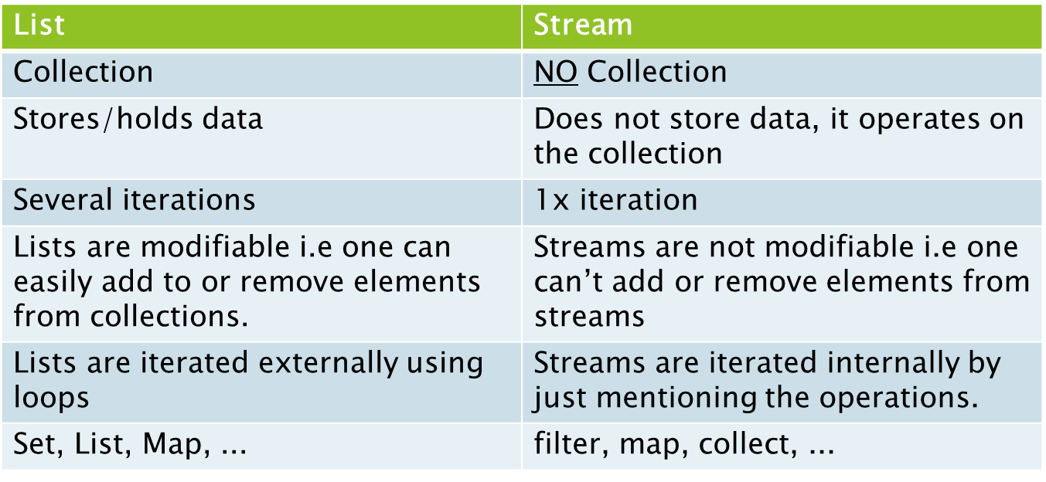
List vs Stream

Slide 14
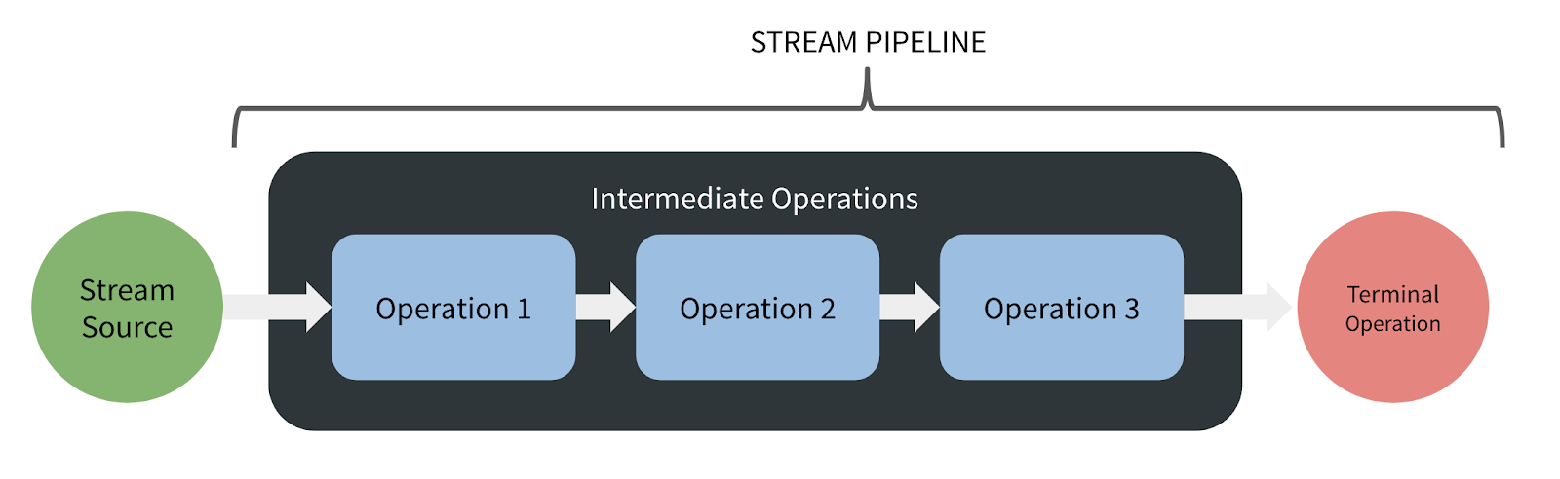
Streams
Streams don’t change the original data structure, they only provide the result as per the pipelined methods and don’t change the original data structure.
Each intermediate operation is lazily executed and returns a stream as a result, hence various intermediate operations can be pipelined.
Terminal operations mark the end of the stream and return the result.

Slide 15
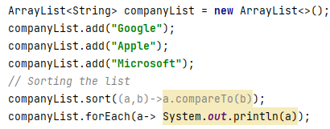

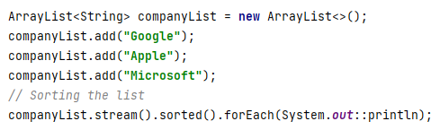
Collection-methods vs Stream– Examples

Slide 16
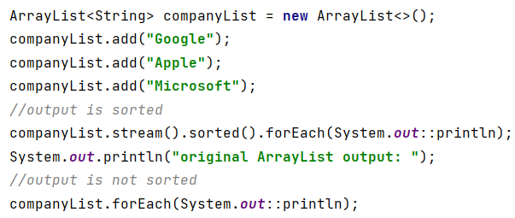
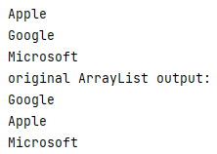
Stream – Example1
stream() and sorted() are intermediate pipeline operations and return a stream
forEach is a terminal operation
content of companyList has NOT changed

Slide 17
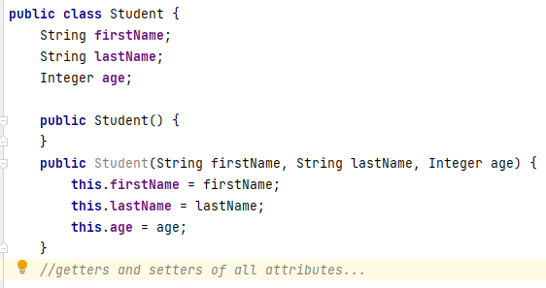
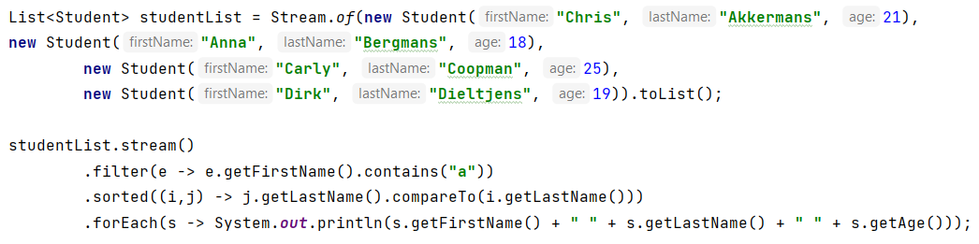

Stream – Example2
Stream.of() : to create a stream
toList(): to create a new List
sorted(): to sort the stream according to the natural order.
sorted(Comparator<? super T> comparator): to use a different order and/or define a different element to sort on

Slide 18
Other interesting stream-methods
Intermediate operations (https://www.javacodegeeks.com/2020/04/java-8-stream-intermediate-operations-methods-examples.html)
.filter(Predicate)
.map(Function)
.peek(Consumer)
.skip(Long)
.sorted(Comparator)
Terminal operations:
.collect(Collectors.toList());
.findFirst();
.anyMatch(Predicate);
.noneMatch(Predicate);
.count();

Slide 19
Conclusion
Lambda expressions are very interesting to use because:
the code is concise
they make it easier to work with collections and streams
However there are some downsides for using Lambda Expressions and functional programming in general:
functional programming make the code less readable (and therefore less maintainable)
debugging is more difficult
video

Slide 20
Introduction to Unit Tests

Slide 21
What’s a unit test?
Automated test
Fully Controls all the pieces it is testing
Are isolated
Are independent of each other
Runs in memory
Is consistent
Fast
Tests a single concept/class
Readable
Maintainable

Slide 22
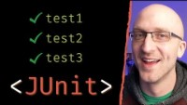
Unit Testing in IntelliJ
video

Slide 23
Syntax to remember
Interesting links:
https://junit.org/junit5/docs/current/api/
https://junit.org/junit5/docs/current/api/org.junit.jupiter.api/org/junit/jupiter/api/Assertions.html
Necessary imports:
import org.junit.jupiter.api.Test; import org.springframework.boot.test.context.SpringBootTest; import static org.junit.jupiter.api.Assertions.*;
assertArrayEquals:
to compare an expected array with an actual value
assertEquals:
to compare an expected value with an actual value
assertNotNull / assertNull:
to check whether an actual value is null of not null
assertTrue / assertFalse:
to check whether an actual value is true or false

Slide 24
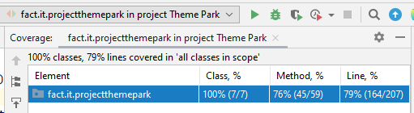
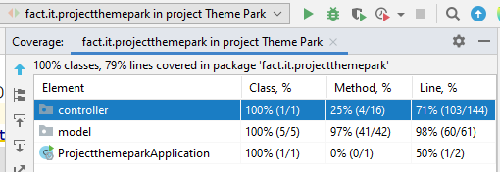
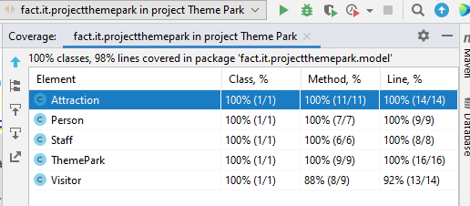
Testing with coverage information
After writing the tests, you can check the coverage of your tests with
Example of result:
Opening the folder gives you more insights:

